Slide 1

SCDU Endocrinologia
Dipartimento di Scienze della Salute
Università del Piemonte Orientale

Slide 2

DISCLOSURES
Abiogen; Amryt/Chiesi; Astra Zeneca; Boheringer; Difass International; Caelus Health; Menarini; Novartis; Novo Nordisk; Probiotical , Sanofi; Therascience

Slide 3



Slide 4
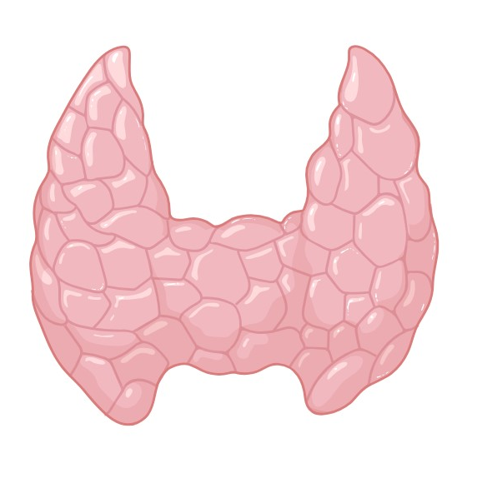

HPT in OBESITY
Santini F et al, EJE 2014

Slide 5
HPT in OBESITY
In morbid obese patients, TSH is moderately increased
The slightly elevated TSH encountered in obese patients is reversible with weight loss and due to the increased adiposity
Morbid obesity is characterized by a slight pituitary resistance to thyroid hormones that is reversible with BS-induced weight loss
Cordido M et al, J Clin Med 2022

Slide 6
HPT in OBESITY after BS
T3
TSH
fT4
T4
Guan B et al, Obes Surg 2017

Slide 7
Thyroid hormone treatment after BS
Cordido M et al, J Clin Med 2022

Slide 8
Thyroid hormone treatment after BS
MALABSORPTION?
Drug dissolution and solubility may be potentially altered in restrictive procedures that increase gastric pH in the newly stomach
Highly lipophilic drugs are more likely to be affected because they are often dependent upon the availability of bile acids to enhance solubility
Lipophilic agents also undergo enterohepatic recirculation
Bypass of the upper small intestine limits the mixing of such drugs with bile acids to the common (post-anastamotic) limbs of the distal small intestine
Jejunoileal bypass may also result in bile acid wasting
As microbiota can modulate both the absorption and the metabolism of drugs, they may constitute a missing link in the assessment of pharmacokinetic changes after BS (understudied area)
Fallahi P et al, Front Endocrinol 2021

Slide 9
SOFT-GEL
TABLETS?
RYGB
BPD
Fallahi P et al, Obes Surg 2017

Slide 10
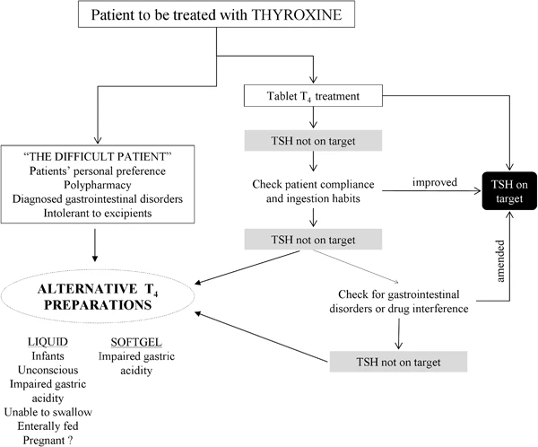
Virili C et al, Endocrine 2016

Slide 11

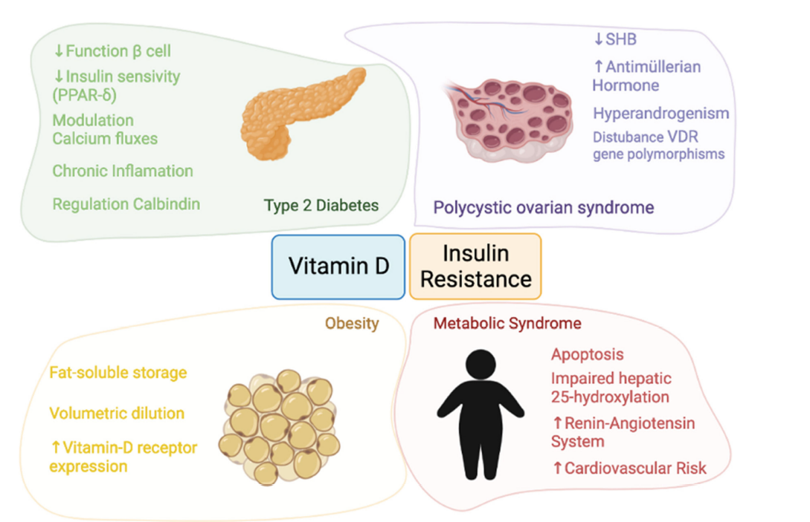

VD in OBESITY
Contreras-Bolivar V et al, Nutrients 2021

Slide 12
VD in OBESITY after BS
Giustina A et al, Rev Endocr Metab Disord 2023

Slide 13
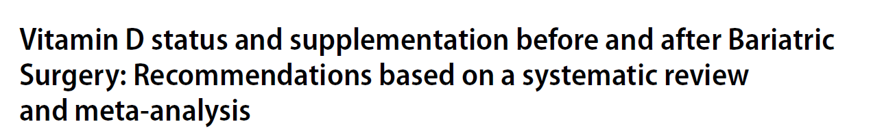
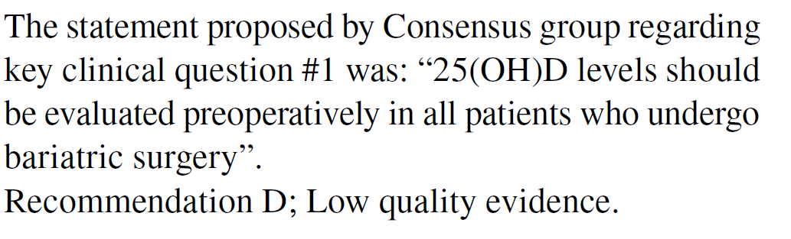
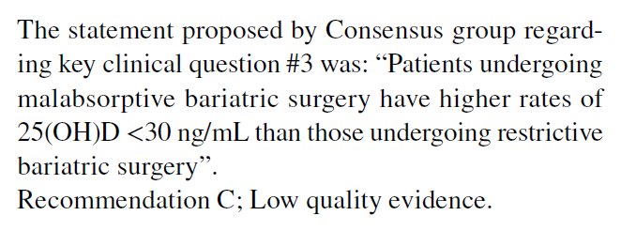
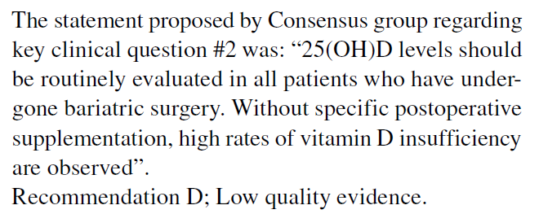
PREVALENCE
Giustina A et al, Rev Endocr Metab Disord 2023

Slide 14
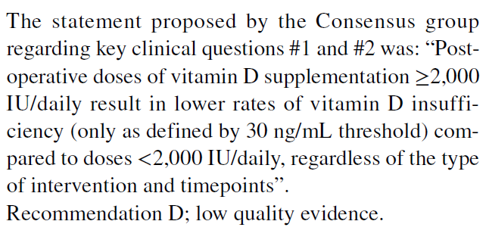
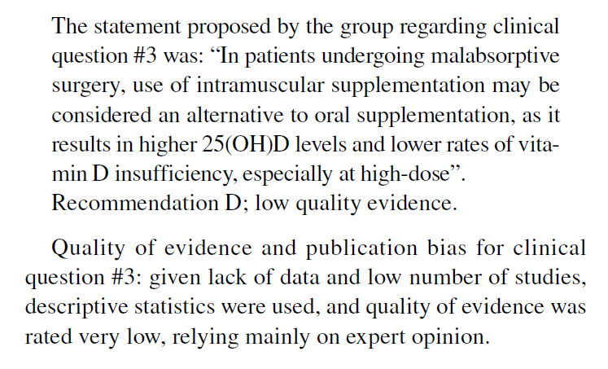
TREATMENT
Giustina A et al, Rev Endocr Metab Disord 2023

Slide 15
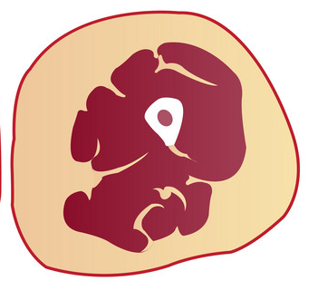
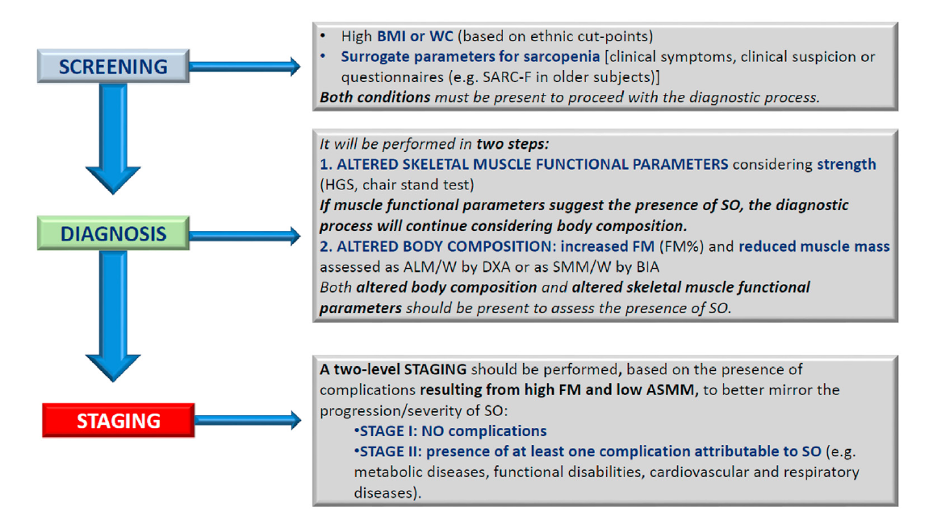
SARCOBESITY
Donini LM et al, Clin Nutr 2022
Seo E et al, Rev Endocr Metab Disord 2023

Slide 16
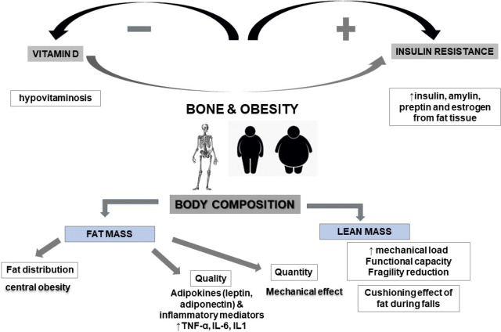
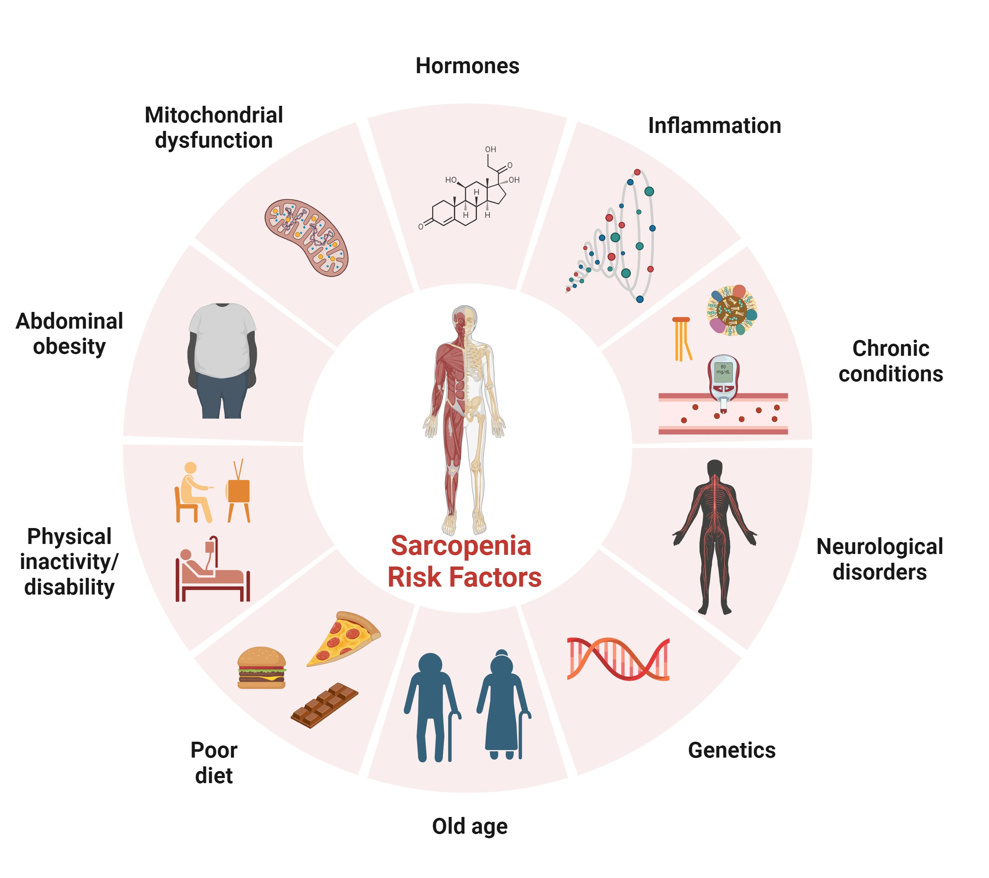
SARCOBESITY

Slide 17
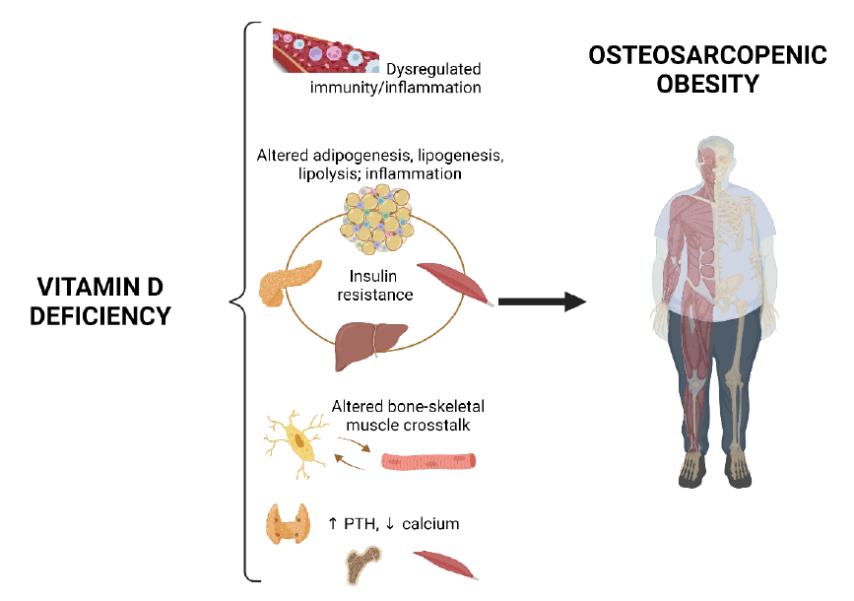
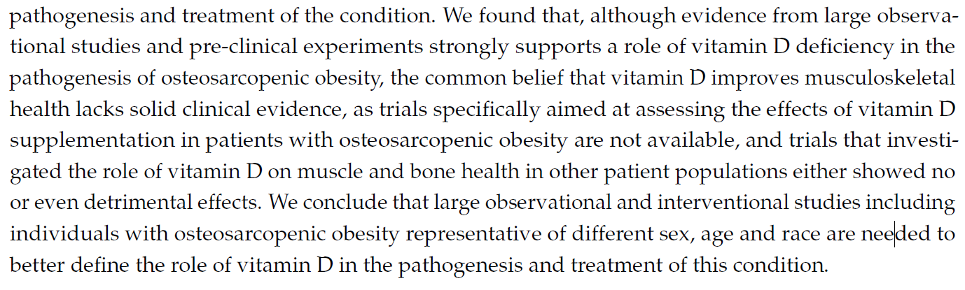
VD in SARCOBESITY
D Filippo L et al, Nutrients 2022

Slide 18


Pro-atrophic Effect of Vitamin D Binding Protein in Skeletal Muscle and Its Involvement in Cancer-Induced Muscle Wasting
Filigheddu N, Raiteri, Reano S, Scircoli A, Antonioli A, Prodam F

Slide 19
SARCOBESITY in BS
There is currently no consensus or definition regarding the research and clinical use of sarcopenia in patients undergoing BS
The current consensus on the diagnosis of sarcopenia in the general population recommends sequential assessment of muscle strength and mass
It seems thar that in patients undergoing BS, the assessment of muscle mass should take precedence over the evaluation of muscle strength.
detailed evaluation of muscle quality should be conducted.
Tracking changes muscle mass, quality, and function before and after bariatric surgery offers valuable clinical insights for identifying patients who would benefit from enhanced lifestyle guidance or more intensive treatment.
Further evaluation of potential postsurgical complications will enable the assessment of the effectiveness and validity of surgical interventions.
Seo E et al, Rev Endocr Metab Disord 2023

Slide 20
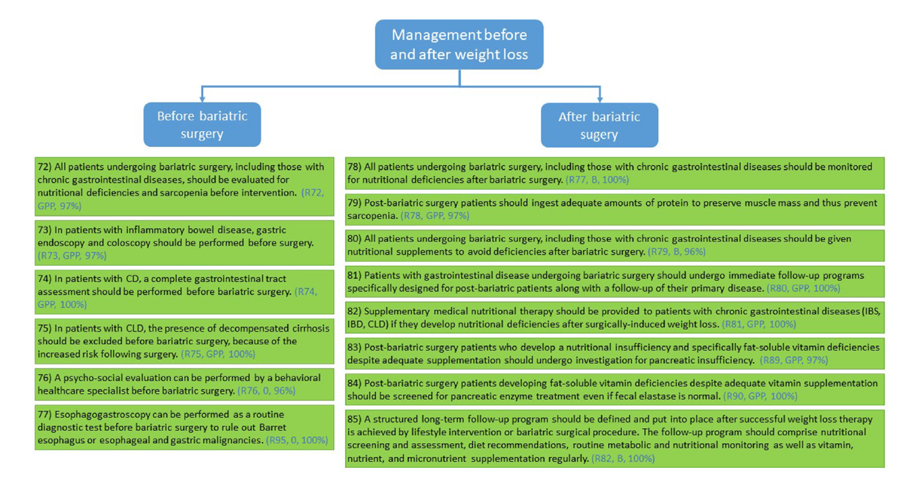

SARCOBESITY in BS
Prot: 60-90 g/die
or 1.2-1.5 Kg/IBW
Supplements
Bischodd SC et al, Clin Nutr 2023
Notes:
Anche supplementi B1, B12, D, carnitina e Zn che possono favorire l’obesità

Slide 21






Endocrinologia,
Dipartimento di Medicina Traslazionale
UPO, Novara
Divisione di Pediatria,
Dipartimento di Scienze della Salute
UPO, Novara
Gianluca Aimaretti
Marina Caputo
Tommaso Daffara
Alice Ferrero
Paolo Marzullo
Grazia Mauri
Maria Teresa Samà
Marco Zavattaro
Leonardo Bighetti
Beatrice Cavigiolo
Samuele Costelli
Martina Borrini
Giuliana Di Gesù
Giulia Marsan
Chiara Mele
Edoardo M. Mollero
Rosa Pitino
Francesca Pizzolitto
Martina Romanisio
Sara Sturnia
Davide Vimercati
Alessandro Antonioli
Jessica Baima
Daniele Spadaccini
Sabrina Tini
Simonetta Bellone
Ivana Rabbone
Alice Monzani
Cristina Partenope
Silvia Savastio
Valentina Antoniotti
Valentina Mancioppi
Immunologia
Patologia Generale
Dipartimento di Scienze della Salute
Università del Piemonte Orientale
Novara
Dipartimento di Medicina Traslazionale
Università del Piemonte Orientale
Novara
Chimica degli Alimenti
Dipartimento di Scienze del Farmaco UPO, Novara
Annalisa Chiocchetti
Giuseppe Cappellano
Umberto Dianzani
Davide Raineri
Alessia Provera
Salvatore Sutti
Nicoletta Filigheddu
Simone Reano
Tommaso Raiteri
Marcello Manfredi
Marco Arlorio
Jean Daniel Coisson
Monica Locatelli
DISIT, DISSTE
UPO, Alessandria e Vercelli
NUTRICIA RESEARCH FOUNDATION
Microbiologia,
DISAFA
Università di Torino
Elisa Bona
Alice Caramaschi
Luca Simone Cocolin
Ilario Ferrocino

